Slide 1
How to create a snapshot of VM

Slide 2
All configuration options and settings visible in this presentation can be different than yours. It depends on your privileges, settings and agreement.

Slide 3
Log in to VM Cloud Services

Slide 4
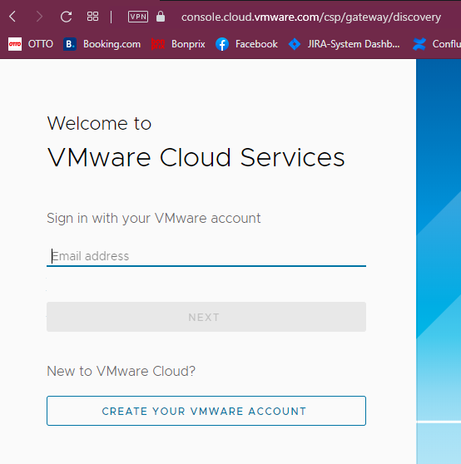
Enter the email address previously added to VMware Cloud Services

Slide 5
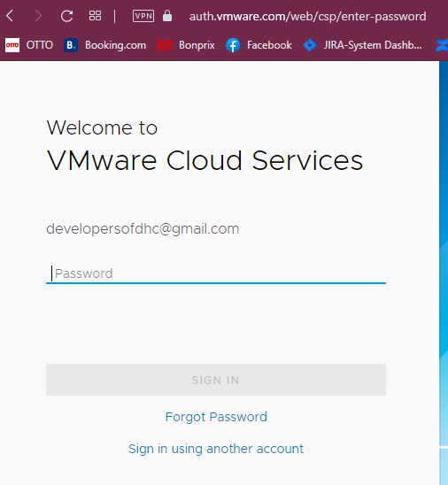
Enter the password for your account

Slide 6
Create the snapshot

Slide 7
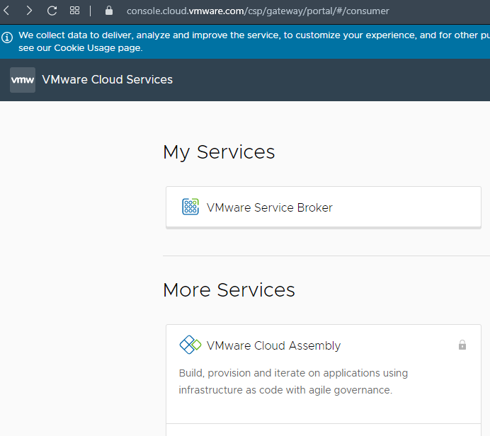
In Section “My Services” find a block with the title “Vmware Service Broker” – click on it.
Notice:
look of this page is up to your privileges and roles which are assigned to your account

Slide 8
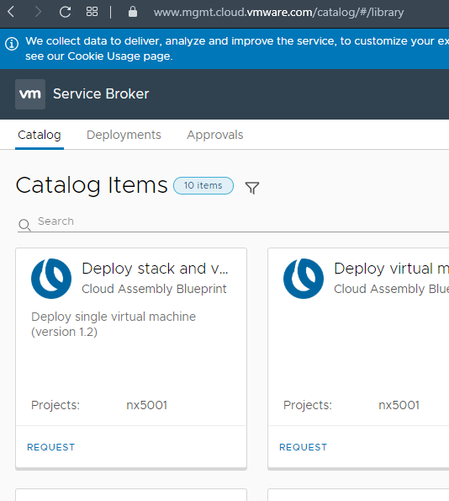
Please find the card “Deployments” on the top of a page. Click on them.
Notice:
You have to have already deployed Virtual Machine. Without VM you cannot add a disk to them.

Slide 9
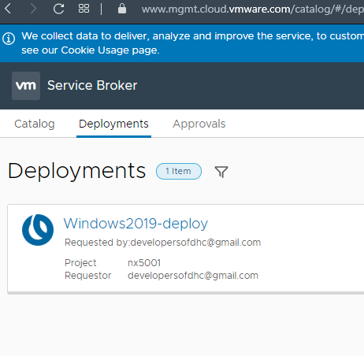
Find the machine you want to add the disk to. When you find an appropriate machine, click on the title of a finished process.
Notice:
On the page you can see many of finished processes which deployed a single machine or series of machines. To identify the machine look on the title of a finished process.

Slide 10
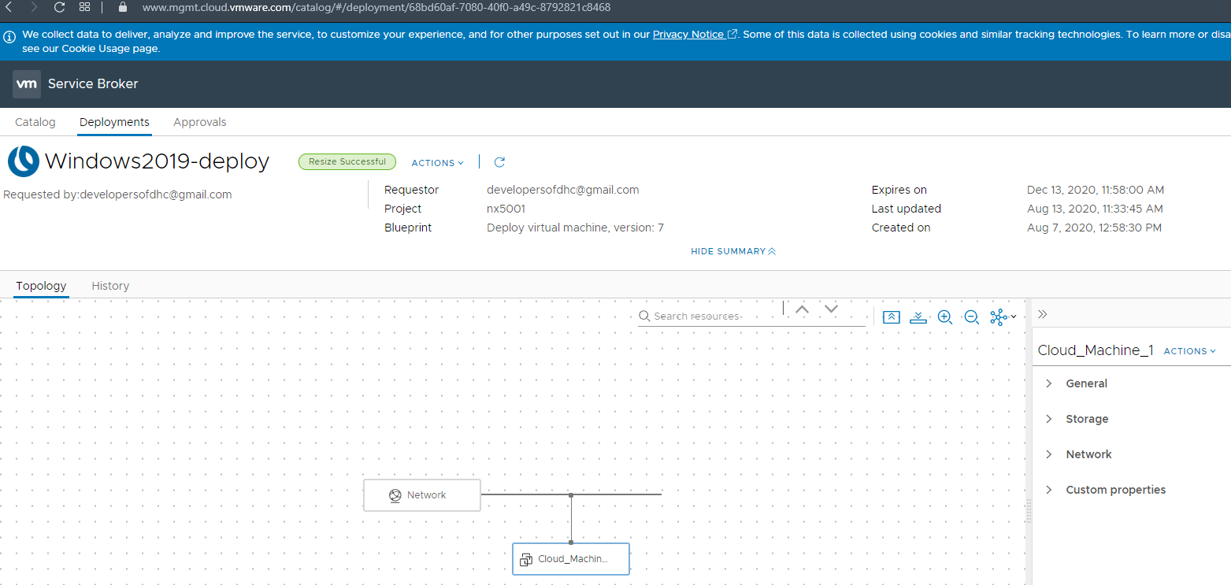
Click “ACTIONS” on the menu on the right.

Slide 11
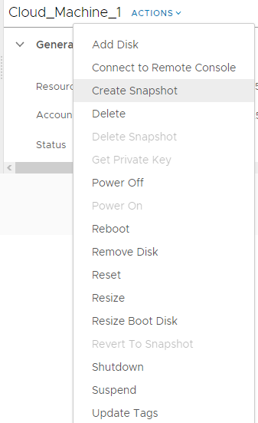
In the menu find the “Create Snapshot” and select it. You will see new windows which allow you to define a new snapshot for VM.
Notice:
This option like others can be disabled. It depends on your privileges.

Slide 12
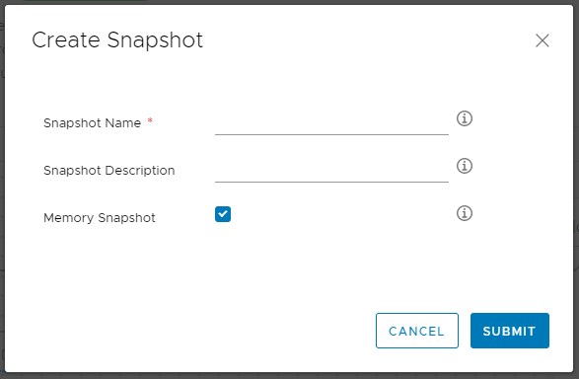
Name of a snapshot – necessary field
Short description - describe a snapshot which you create.
Checkbox which allows you to create a snapshot with memory.
When you fill in this form click SUBMIT

Slide 13
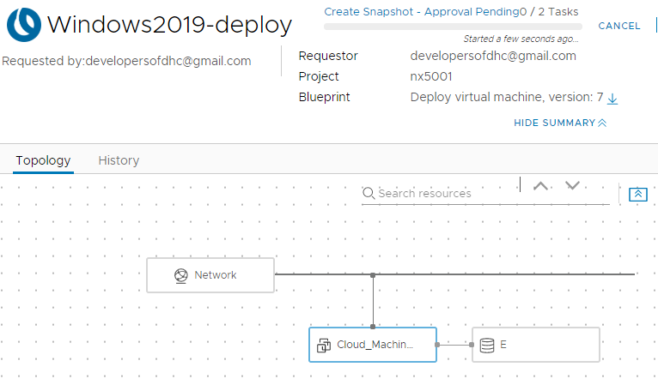
Status of a process creating the snapshot

Slide 14
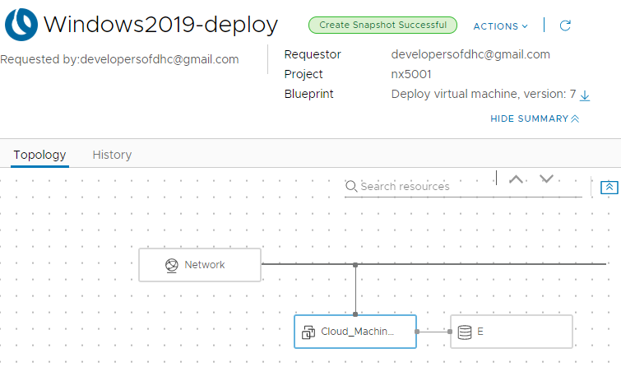
Status of a process
Notice:
When the process ends with an error, the label will be red with information about the error.

Slide 15
Thank you For more information please contact: T+ 33 1 98765432 M+ 33 6 44445678 firstname.lastname@atos.net

